Slide 1
Unit 5
Designing the work place,
Inventory control, material handling and quality control.
Marketing functions, market segmentation, market research and channels of distribution,
Sales promotion and product pricing.

Slide 2

Important marketing functions
Introduction
What is Marketing?
✓
Marketing is identifying and meeting human and social needs. Thus, it is
“meeting needs profitably.”(Shivendu Mishra: 2009).
✓
-
Marketing must be understood not in the old sense of making a sale 'selling' - but in the new sense of satisfying customer needs (Antharjanam, 2012).
✓
It then refers to the identification, selection and development of a product, determination of the price, channel to reach customers place and the development and the implementation of promotional strategy.
✓
In other words it is the process of planning, pricing, promoting, selling, and
distributing ideas, goods or services to create exchanges that satisfy customers.
✓
Thus everything that happens between generated idea, produced goods and the sale

Slide 3







Important marketing functions
Marketing Functions…
Marketing Functions
✓ It is often asserted that marketing serve as a bridge between producers and
consumers.
✓ This property of marketing is achieved through marketing functions
✓ Thus, market function is a link between producers and consumers
Marketing Bridges the Gap!
Producers
Marketing
Functions
Consumers

Slide 4
Important marketing functions
Marketing Functions…
Various of marketing functions
✓ There are several components of marketing functions. These include
✓ Researching
✓ Pricing
✓ Buying
✓ Promotion
✓ Distribution
✓ Storage
✓ Processing
✓Product development and management
✓Standardization and grading
✓Market Information
✓Financing
✓Selling
✓Risk Bearing
✓After sales-service
✓The fulfillment of these functions in a particular place/culture/commodity
varies widely, but all the functions are needed in any macro-marketing system.

Slide 5
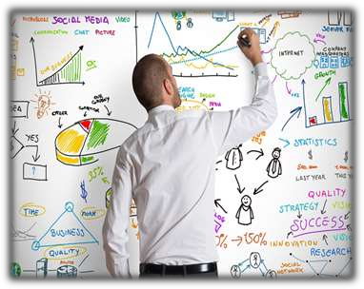

Important marketing
Marketing Functions…
functions
Research function:
✓
The collection, analysis, and distribution of
all the information the marketer needs to plan, implement, and control need-satisfying marketing activities.
that function of marketing that makes it possible for adequate information regarding a particular market of target to be generated.
Research must be carried out to identify the size, behaviour, culture, believe, genders etc. of the target market segment, the needs and want.
Effective product is then developed to meet and satisfy the market needs and want.
✓
✓
✓

Slide 6
Important marketing functions
Marketing Functions…
Pricing Function
✓ The process of coming up with an amount to charge each customer for a produce/product/ service.
✓ Prices must be seen by customers as fair, i.e. not too high or too low but it
must also allow the marketer/producer to make a fair profit.
✓ Basic questions to consider in deciding the price for goods and services
✓ What will customers pay?
✓ How much does it cost us to produce?
✓ How much do competitors sell for?

Slide 7
Important marketing functions
Marketing Functions…
Buying function
✓ The function of buying is performed in order to acquire quality materials for production.
✓ When a good product concept is designed, it must also be ensured that
essential materials are purchased for the product.
✓ This function is carried out by the purchase and supply department,
✓ The specifications of materials goes a long way in assisting the purchasing
department to acquire the necessary materials needed for production.

Slide 8
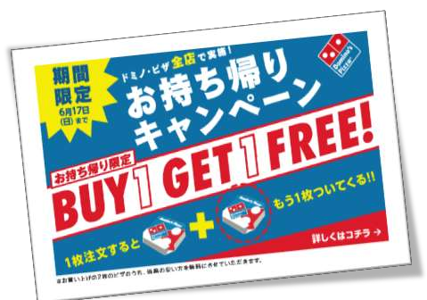
Important marketing functions
Marketing Functions…
Promotion
✓ The effort to inform or persuade customers about a business’s products or
services.
✓ Designing effective communication strategies to inform, persuade, or remind
consumers/target/potential market
product.
about
the
availability
and
features
of
a
✓ Some of the strategies include;
✓ advertisement,
✓ personal selling,
✓ public relation etc.

Slide 9
Important marketing functions
Marketing Functions…
Storage
✓ Holding an inventory of goods until needed by customers.
✓ products must be stored and protected until they are needed.
✓ This function is especially important for perishable products
vegetables.
such as
fruits
and
Processing
✓ Processing involves turning a raw product into commodities that
preferred or can easily be used by consumer.
are more
✓ For example, like converting wheat into bread/ paddy into rice

Slide 10
Important marketing functions
Marketing Functions…
Distribution
✓ It is the process of ensuring that produce/product is easily and effectively moved from the point of production to the target market to enable the produce/product to be easily accessed by consumers.
✓ Thus it is the process of ensuring that produce/goods
consumers/customers.
get in
the
hands
of
✓ It involves considering:
✓ the kind of transportation system to employ e.g. Road, rail, water or air,
✓ Involves the systems that track products
✓ the kind of middlemen to engage in the channel of distribution, their incentives and
motivations etc.

Slide 11
Important marketing
Marketing Functions…
functions
Risk Bearing:
✓ Risk is the probability or threat of damage, injury, liability, loss or any other negative occurrence that is caused by external or internal vulnerabilities and that may be avoided through preventive action.
✓ The process of marketing is characterized with lots of risks, such risks as
produce damaging, pilferage, price fluctuations, storage loss etc.
✓ Thus risk bearing is assuming responsibility for uncertainties
✓ Hence marketers should have the capacity to bear risk such as:
✓ effective packaging system to protect produce,
✓ good warehouse for the storage of your produce until they are needed,
✓ effective transportation system to speedily deliver produce on time.
✓ Effective production system (e.g. Diversification, merging, insurance, integration) to cater for price fluctuations, natural disasters, theft, etc

Slide 12
Important marketing functions
Marketing Functions…
Product development and management
It is a process whereby the market needs or wants are identified which are later on factored into the produce / product during the product design to enhance produce or product quality or acceptance in the market.
✓
✓
Product development
marketers to develop a
passes through some basic stages carried out by the
targeted market specified product.
✓
Produce/ Products can
be managed by evaluating its performance and changing
them to fit the current market trend.
✓
In a nutshell, it is obtaining, developing, maintaining and improving a product or
a product mix in response to market opportunities or demands
✓ Marketing research helps you know what customers want

Slide 13
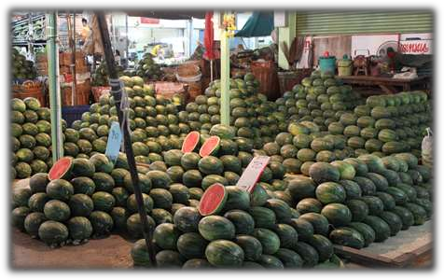
Important marketing functions
Marketing Functions…
Standardization and Grading
✓ The function of standardization is to establish specified characteristics produce/product must conform to, such standard as in having a specific ingredient etc. That makes the product brand so unique.
that
test,
✓ Grading comes in when you sort and classify your product into deferent sizes or
quantities for different market segment while maintaining the product standard.

Slide 14



Important marketing functions
Marketing Functions…
Market Information
✓ Information from
around the
world
about market
conditions,
weather, price
movements,
and
political
changes, can affect the marketing process.
✓ Market
information
is provided
by
all
forms of
telecommunication, such as television, the internet, and
phone.

Slide 15
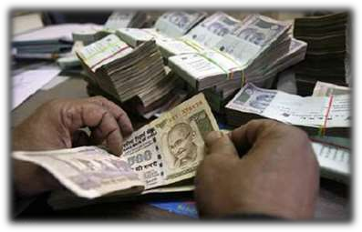
Important marketing functions
Marketing Functions…
Financing
✓ It refers to raising funds/capital to start operation and remaining in operation.
✓ It also refers to the modes of payment for the goods and services transferred costumers.
to
✓ Thus it is providing the necessary cash or credit to produce, transport, store,
promote, sell, and buy products.
✓ In simple words it refers to getting money that
and running a business.
✓ Loans, selling stock, etc.
✓ Also involves ways that customers can pay
✓ Credit cards
✓ Billing
✓ Payment on delivery
is
necessary
to
pay
for
setting
up

Slide 16
Important marketing functions
Marketing Functions…
Selling
✓ Providing customers with the goods and services they need and educating them
on those goods and services so they can make an informed buying decision.
✓ Provides customers with the goods and
✓ In retail stores
✓ Business-to-business (B-2-B)
services they want
✓ Involves:
✓ Determining client needs
✓ Persuading and influencing decisions
✓ Responding to reactions
✓ Forming relationships

Slide 17
Important marketing functions
Marketing Functions…
After sales-service
In a more complex and technical product, marketers should make provision
order to assist customers after they have purchased product.
In terms of machines or heavy equipment product that requires installation
✓
in
✓
or
maintenance, most marketing organization renders such services like installing
the machine or maintaining it for stipulated periods on time for free or by a little service charge.
After sales services is an effective marketing strategy to building a long lasting customer relationship, staying ahead of your competitors while making profit.
✓
✓
After sales service enables a marketer to know what is required to be done to
having an effective transfer of ownership to costumers, creating a big picture,
while also making profit

Slide 18
Important marketing functions
Importance of marketing functions
✓
Market functions help the macro-marketing system to overcome separations
and discrepancies between those wishing to participate in an exchange.
✓
Setting and communicating the value of products and services. E.g. price
setting at right level
✓
Designing, developing, maintaining, improving and acquiring products and
services that meet consumer needs.
✓
Determine the quality manners for consumers to locate and use services &
products of the entity.
✓
They care for organization’s budgeting,
✓
Obtaining, managing and using information about what consumers wants,
improve entity decision making activities, and determining what will sell.
✓
Good communication with the customers determine and satisfy their needs

Slide 19
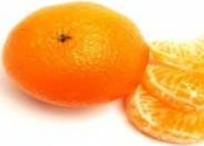
• Markets are Heterogeneous; Segmentation divides
the consumer of that product
into several sub units, or sub markets, each relatively more
homogeneous within itself, compared to market into a
number of sub markets/ distinct sub units of buyer , each
with relatively more homogeneous characteristics, is known
as market segmentation.
into Homogeneous Sub-Units
The market for a product is nothing but the aggregate of
•
•
Markets break up the heterogeneous market for product

Slide 20


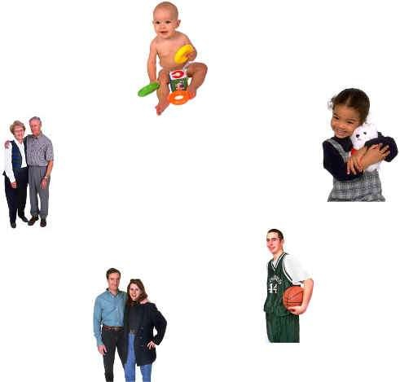

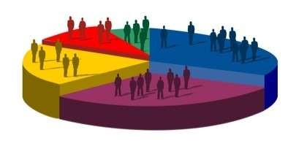
What is market segmentation?

Slide 21
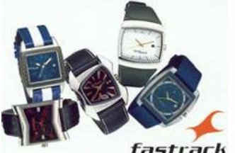
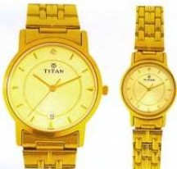

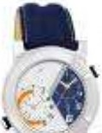

For the youth /the ou
Example of market segmentation?
Titan Watches
For
the
youth
/the
outdoor
lovers:
For Designer Segment
Arrives in three broad
Segments
•
•
•
The
The
The
Rich
Middle
Lower
For the Gold lovers:
For Children Segment
•
.
~7917YM04=:J

Slide 22
Facilitates
Facilitates
Makes the
Right Choice of Target Market
Effective Tapping of the Chosen Market
Marketing Effort More Efficient and Economic
Helps Identify Less Satisfied Segments and Concentrate on
Them

Slide 23

•
A
market/ consumer
population
for
a
product
can
be
segmented using
include:
Geographic
Demographics
Socio-cultural
Psychographic
Buying Behavior
several
relevant
bases.
The
major
ones
•
•
•
•
•

Slide 24
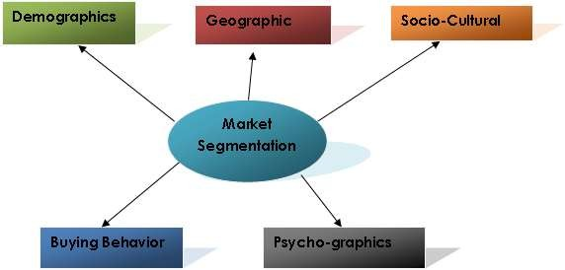
Bases for segmentation

Slide 25
Bases for segmentation
Segmentation of consumer based on factors like climate zone,
continents/ country, region, state, district, and urban/rural area,
constitutes geographic segmentation
Marketer,
who
operate
globally,
often
segment
the
market
segments the market by continents/country/region in the first
instance, and then go for segmentation on other bases.
National markets within a country like India, often segment
the market by region, state, district and urban/rural area, in the first instance, and then go for segmentation on other bases.

Slide 26
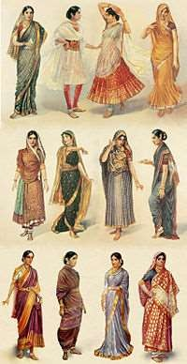

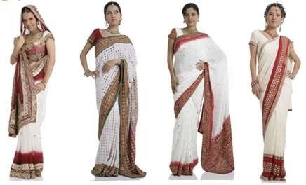
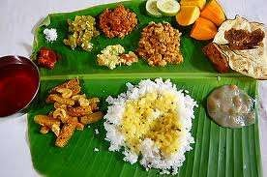
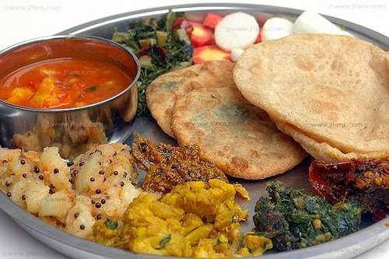
Bases for segmentation

Slide 27
Bases for segmentation
Demographical
Segmentation of
consumer based on variables such as race,
religion, community,
language,
age,
size,
stage
in
family
cycle,
gender,
marital
status,
family
occupation,
economic
position/income/purchasing capacity level, and social status ,of
the consumer demographic segmentation
Age: Based on age on can have the 1) Infants
2) Child
Market
Market
Teen
Market
3) Youth
Market
4)
Middle
Aged
5)Elders Market
Genders: On the basis of gender, the consumer market classified into male market female market.
may be
Social Class: Companion design their products and services for
particular social classes. There are three social classes: 1 Upper
classes 2. Middle classes 3. Lower class

Slide 28
Bases for segmentation
Culture and social class are the two main bases of segmentation
here.
Culture: Culture influence consumer behavior, deeply.
A given
culture brings in its own unique pattern of
social conduct. A
person
usually
acquires
his
cultural
attributes right
at
his
childhood.
Culture
includes
religious,
caste,
traditional,
language, pattern of social behavior .
Social Factor: Social group of varying types exert influenced on
the consumer.
Social group include family, peer group, close
colleges. They adopt their common life style.

Slide 29


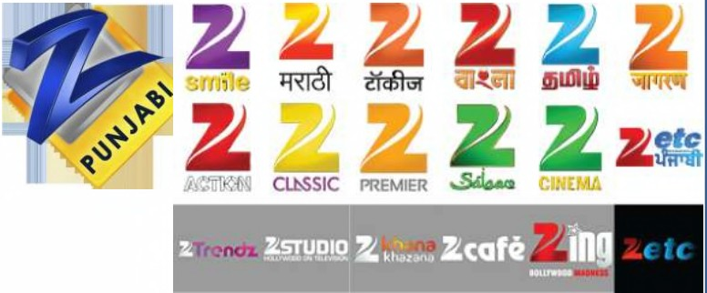
Bases for segmentation
Example:
sports channel, movie channel.
veg burger for vegetarian and nonveg burger for non vegetarian.
•Zee Televisions deals with variety of channels regional channel,
•McDonald has both veg and non veg burger. McDonald has

Slide 30
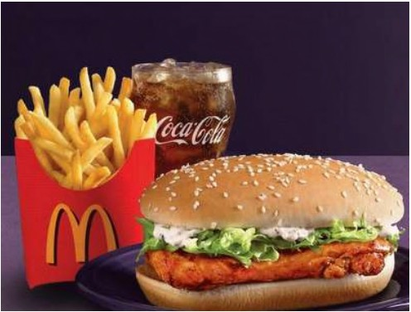
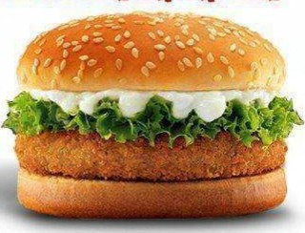
Bases for segmentation
Example:
sports channel, movie channel.
veg burger for vegetarian and nonveg burger for non vegetarian.
•
•^{Zee Televisions}
•^{McDonald has}
deals with variety of channels regional channel,
both veg and non veg burger. McDonald has
mPOifl!Jll

Slide 31
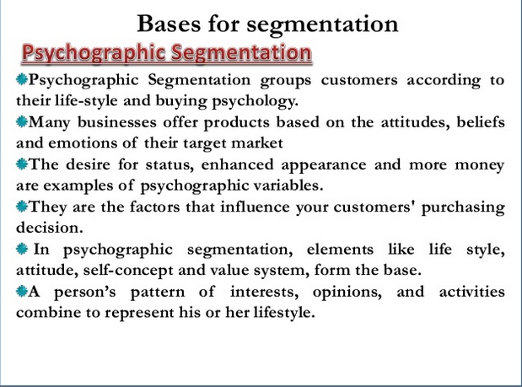

Slide 32
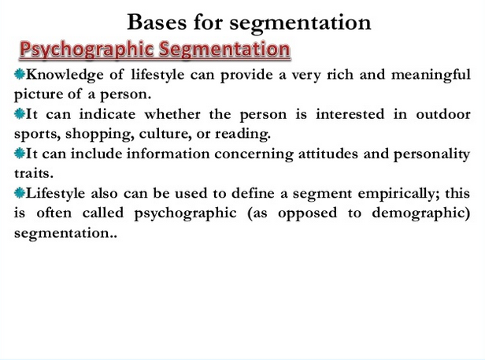

Slide 33


Bases for segmentation
. .
^{\UN\lt}-^{K}

Slide 34
Bases for segmentation
Behavior segmentation
basis of their knowledge, attitude, use, or response to a product.
Such behavioural variables are discussed below
Benefits sought : (Colgate- White teeth stops bad breath,
Cibaca Provides Therapeutic benefits, Vicco vajradanthi and
neem gives ayurvedic benefit)
users)
Loyality status: (Hard core loyals, Split Loyals(Two r Three
brans), Shifting Loyals (Shift from one brand to another),
Switchers (No loyalty to any brand))
Positive, Indifferent, Negtive and Hostile)
•The customer can also be divided into certain
Occasions : (Marraiges, festival occasasions)
•
segments
on
the
•^{User}
Status:
(Ex-users,
first
users,
regular
users,
Potential
Usage rate: (Light, Medium, and heavyu user segments)
•
•Attitude: Customers are divided into five groups(Enthusiastic,

Slide 35
Advantages of Segmentation
Various advantages of market segmentation are:-
given market
Facilitates effective tapping of the market.
•
such segments.
Helps spot the less satisfied segments and succeed by satisfying
such segments
as well.
•Helps distinguish one customer group from another within
Facilitates proper choice of target market.
•
a
•Helps divide the markets and conquer them.
Helps crystallize the needs of the target buyers
Makes the marketing effort more efficient and economic
•Helps spot the less satisfied segments and succeed by satisfying
Makes the marketing effort more efficient and economic
•
•Brings benefits not only to the marketer but also to the customer

Slide 36
Market Research
Definition
Types of Market Research
Steps in Market research

Slide 37
Definition
Market research, which includes social and opinion research, is the systematic gathering and interpretation of information about individuals or organisations using the statistical and analytical methods and techniques of the applied sciences to gain insight or support decision making. The identity of respondents will not be revealed to the user of the information without explicit consent and no sales approach will be made to them as a direct result of their having provided information.
Source – ICC/ESOMAR International Code on Market and Social Research

Slide 38
Types of Market Research
Primary
New research carried out on a particular topic
Secondary
Research using existing published sources of relevant information.
Qualitative
Research that seeks customer opinions and views. For example, a Market Researcher may stop a consumer who has purchased a particular type of bread and ask him or her why that type of bread was chosen.
Quantitative
Research where results can be expressed in numbers. For example, a bank might ask its customers to rate its overall service as either excellent, good, poor or very poor. This will provide quantitative information that can be analysed statistically.

Slide 39
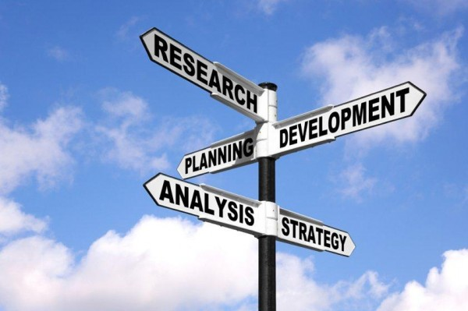
Steps in Market Research
Planning
Developing Questionnaire
Research – Data collection
Analysing – Data
Using the data – Strategic Decision Making

Slide 40
Planning – Why What When How
Creating Awareness: If goal is to create awareness in the market about your product or service, the research should center around attitudes, usage, public relations and advertising messages.
Retention: If goal is to increase purchases from current customer base and enhance customer loyalty, research should center around customer satisfaction and behavioral insights.
Targeting: If goal is to determine which segment of the population has the highest return on investment, research should center around brand positioning and competitive analysis.
Acquisition: If goal is to optimize marketing message to acquire more sales, research should center around product concept, usability, pricing and advertising testing.

Slide 41
Developing Questionnaire
Design the questionnaire with the objectives in mind
Ensure majority of the questions are quantitative. Quantitative data produces data that are objective and can be acted on.
Minimum number of questions should be quantifiable to avoid survey fatigue and abandonment
Questionnaire should have relevant questions . Misleading question will result in poor irrelevant data
Avoid questions that are –
Leading
Sensitive
Personal
Offensive
Questions should be –
Simple
Specific
Direct

Slide 42
Research – Data Collection
Sample Size
It is not realistic to think that entire marketing population can be covered for a survey an adequate percentage and cross-section of target consumer is needed.
Distribution Method
Choosing the right distribution method to collect your data is important. Different modes introduce different forms of bias so carefully consider your target audience and the best channel for reaching them. Eg - For instance, if your target audience is the elderly, social media or internet channels may not be the best distribution options. Direct mail, phone or personal interview may be the best option for reaching this audience.
Consider other distribution methods such as QR code or web address on receipts, newsletters and printed brochures.
If there are variations in the target population or statistically significant differences are to be noted between subgroups in the sample, the sample size should be adjusted for it.
Perquisite for good data collection

Slide 43
Analysing the Data
Clean your survey data: Identify and weed out responses that have straight-line, Christmas tree, red herring, and/or outlier patterns that can taint the results.
Analyze your data: Analyze the data to determine questions are answered in the format you expected. Unusual trends could indicate a problem with the question or question type. If so, you may need to discount the question or run another study related to the learning objective.
Report your results: Share your findings!
Segment your data: Segment your data by learning objective so that you can truly understand the most significant findings of your research

Slide 44
Make Strategic Business Decisions
Make Decisions
Armed with your market research data, you can confidently make sound management decisions.
Meet with your research stakeholders to discuss your pre-defined course of action. Implement your action plan and measure the results.
Share decisions

Slide 45
Channel Management / Distribution

Slide 46
A channel of distribution perform all of the activities utilized to move a product and its title from production to consumption

Slide 47
Physical distribution is…
Organizing and moving products through the channels (Logistics = ordering, transporting, storing, handling and inventory control)
The 3rd largest expense for most businesses
(#1 Materials #2 Labor)

Slide 48
Explain how channel members add value
Right PLACE
Right TIME
Place UTILITY
Location – having the product where customers can buy it
Time UTILITY
Having the product available when the customer wants/needs it

Slide 49
CHANNEL FUNCTIONS
Information
Promotion
Contact
Matching
Negotiation
physical distribution
Financing
Risk taking

Slide 50
CHANNEL FUNCTIONS (cont.)
Providing marketing information:
Companies rely on market research to determine their target markets’ needs and wants
Ex: small business producing handmade greeting cards
Promoting products:
Can be expensive
Retailers often take a large portion of promotion responsibilities
Ex: local supermarkets/discount stores

Slide 51
CHANNEL FUNCTIONS (cont.)
Contact
Matching
Negotiating with the customers:
Different prices are paid by the wholesaler, retailer and consumers based on negotiation
Physical distribution
Financing and risk taking:
Moving products through a channel costs money
When channel members work together to finance activities and to assume financial risks, channels will be more effective

Slide 52
Explain key channel tasks
Marketing
Packaging
Financing
Storage
Delivery
Merchandising
Personal selling

Slide 53
Explain key channel tasks (cont.)
Providing marketing information
Rely on market research to determine their target markets’ needs and wants
Promoting products
Costs and responsibilities can be shared
Negotiating with customers
Offering to deliver and install products
Reducing discrepancies
Selling large quantities of products to wholesalers and retailers
Financing and risk-taking
Work together to finance activities to become more effective

Slide 54
Length of Channel
Channel length = number of levels in a distribution channel.
2 level
3 level
4 level
5 level
Manufacturer
Manufacturer
Manufacturer
Manufacturer
Agent
Wholesaler
Wholesaler
Retailer
Retailer
Retailer
Consumer
Consumer
Consumer
Consumer

Slide 55
Tasks of Intermediaries - Wholesalers
Break down ‘bulk’
Buys from producers and sell small quantities to retailers
Provides storage facilities
Reduces contact cost between producer and consumer
Wholesaler takes some of the marketing responsibility e.g sales force, promotions

Slide 56
Tasks of Intermediaries - Retailer
Much stronger personal relationship with the consumer
Hold a variety of products
Offer consumers credit
Promote and merchandise products
Price the final product
Build retailer ‘brand’ in the high street

Slide 57
Tasks of Intermediaries - Internet
Sell to a geographically disperse market
Able to target and focus on specific segments
Relatively low set-up costs
Use of e-commerce technology (for payment, shopping software, etc)
Paradigm shift in commerce and consumption

Slide 58
Tasks of a Logistics Manager
plans the flow of materials in a manufacturing organization (beginning with raw materials and ending with delivery of finished products to channel intermediaries or end customers) and coordinates the work of departments involved in the process, such as procurement, transportation, manufacturing, finance, legal, and marketing.

Slide 59
Describe channel management decisions
Decisions about a product’s physical movement and transfer of ownership from producer to consumer.
FIRST - Setting channel objectives
Determine what the company is trying to achieve
Meet the needs and wants of their target market
Give their product a competitive edge
SECOND - Channel members:
Selection
Management
Motivation
Evaluation

Slide 60
1. Selecting Channel Members
Determine the types of members the belong in the channel, as well as the channel length (total number of channel members)
Usually based on the nature of the product
Factors to consider:
Create product value that others cannot or are not willing to provide
Channel the product to its desired market
Have a pricing and promotion strategy compatible with the product’s needs
Offer customer service compatible with the products needs
Be willing and able to work cooperatively with other members within the product’s channel

Slide 61
1. Selecting Channel Members (cont.)
Involves determining the characteristics that distinguish the better ones by evaluating channel members
Do they: Provide value? Perform a function? Expect an economic return ?
Years in business
Lines carried
Profit record
Policies, strategies, & image
Experience & track record

Slide 62
1. Selecting Channel Members (cont.)
Selecting intermediaries that are sales agents involves evaluating
Number and character of other lines carried
Size and quality of sales force

Slide 63
1. Selecting Channel Members (cont.)
Market segment - must know the specific segment and target customer
Selecting intermediates that are retail stores that want exclusive or selective distribution involves evaluating
Store’s customers
Store locations
Growth potential

Slide 64
3. Motivating Channel Members
Develop a cooperative/collaborative and balanced relationship with the partner
Understand the partner’s customers – their needs, wants, and demands
Understand the partner’s business – operationally and financially and what’s really important to them
Look at the partner’s needs in terms of customer support, technical support, and training
Establish clear and agreed upon expectations and goals
Develop recognition programs focusing on the partner’s contributions
Build internal support systems and dedicate resources to the partner

Slide 65
4. Evaluating Channel Members
Produces must evaluate intermediaries performance against such standards as:
Sales quota attainment
Average inventory levels
Customer delivery time
Treatment of damaged and lost goods
Cooperation in promotional and training programs.

Slide 66
4. Evaluating Channel Members (cont.)
Should constantly evaluate the channel:
What is working?
What is not working?
What can be improved?

Slide 67
4. Evaluating Channel Members (cont.)
Risks & Dangers of Distribution Decisions
Transaction costs both apparent & hidden
Risks include loss in transit, destruction, negligence, non-payment and so on.
So, careful choice & evaluation of each & every channel partner is a necessity.

Slide 68
Sales Promotional
For an entrepreneur, immediate sales are extremely important.
For increasing the sales, there are various kinds of promotional campaigns an entrepreneur can consider.

Slide 69
Contests:
Contests are used to call attention to a product when there is nothing new to announce about the product. It is important that the product should tie in with the contest. A photography shop will gain more by having a ‘best photo’ contest than by organizing a tug-of-war between its customers. A contest can also be a good way to build data on customers. An instant win situation, such as a scratch card, has a greater impact than a long-winded contest. It is always better to have lots of prizes than to have one big prize.

Slide 70
Coupons:
Coupons entitle their bearers to an immediate discount when presented to a partici­pating business. The world over, coupons have been seen as the greatest influencer among all promos. P&G had a bad experience when people went to court after it stopped issuing coupons. Coupons can be issued by the manufacturer or the retailer or both. A coupon can be on the product itself, or it can be off site such as in a newspaper rebate coupon.

Slide 71
Discounts
Discounts are given to stimulate demand in periods of low sales. Sometimes, a firm might discover that its discounted sales are much more than their normal sales. Discounting does result in increased sales, but it can also promote new kinds of cons­umption such as buying for gifting purposes. On some occasions, a discount only serves to prepone purchase and can result in postponing purchase in anticipation of a discount. A discount is easy to implement as price reductions are simple and easy to communicate.

Slide 72
Point of Purchase:
Point of purchase, also known as point of sale, is a display tactic where some inducements are given to dealers to prominently display your product. It is not very useful if used all by itself and can yield good results if used in combination with some other promotion. The display unit must be able to communicate the message within three seconds. There are many new attractive self-shipping display units that are easy to set up.

Slide 73
Sampling
Sampling is a very easy way to draw in customers. Some customers will buy because they liked the product and a few will also buy because they feel obliged to, after having sampled the product. Sampling has been used effectively in selling ice creams, cookies, perfumes, video games, and a host of other products.

Slide 74
Organizing Events:
It is very expensive to be officially tied in with an event that draws attention to itself. A better way to associate with the event is to do it unofficially. For example, Pepsi’s ‘Nothing official about it’ campaign during the Cricket World Cup stole the thunder from Coca-Cola, the official sponsor. A new hair salon had a Dhoni look-alike contest during the India-Australia cricket series.

Slide 75
Free Gift:
Retailers in India hold that nothing motivates a shopper more than a free gift. There are a number of opportunities to add a free gift as given here:
i. Packed along with the product
ii. As the container itself
iii. Charging a small cost for it
iv. Free gift can be given with a long-term commitment (subscription)
Some of the most memorable campaigns of iconic brands such as Binaca Toothpaste, Uncle Chipps, Gold Spot, etc., have been built around free gifts.

Slide 76
Trade Promotions:
Trade promotions are targeted at distributors and retailers and are done with the objective of getting new distributors, exploit seasonality, or secure their services for regionally focused marketing activities. Good performance by dealers is also rewarded by bonuses.

